Slide 1
Chapter 2
Basic law

Slide 2
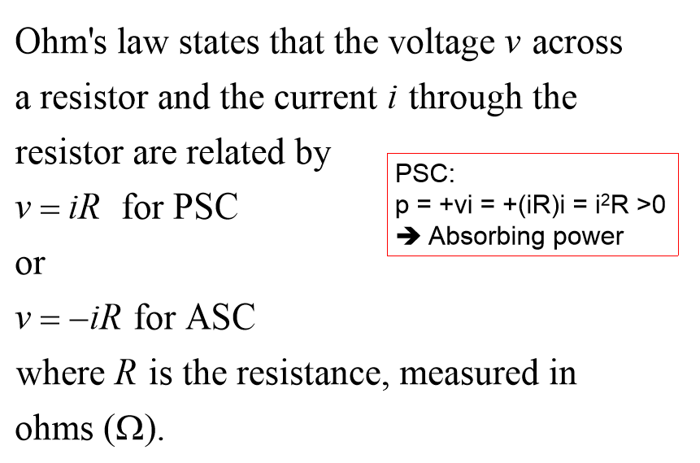

Slide 3
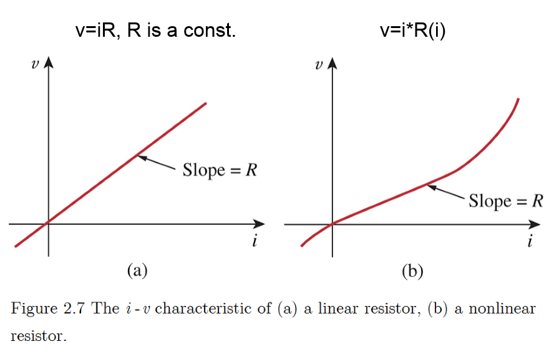
Constant Changeable

Slide 4
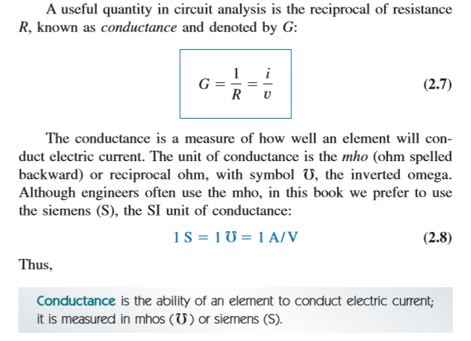

Slide 5
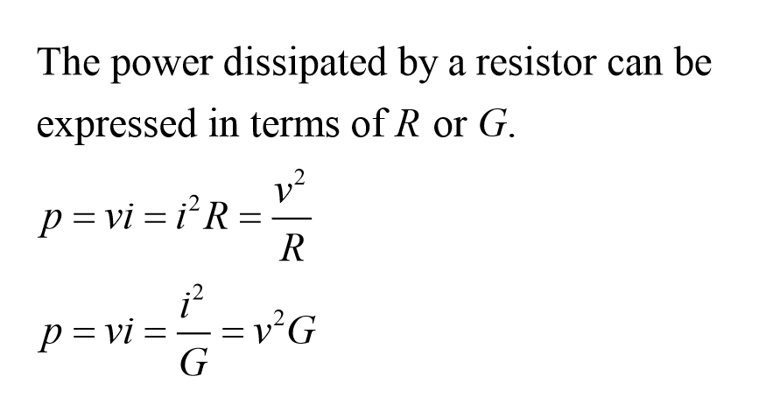
The meaning of G is opposite to R.

Slide 6

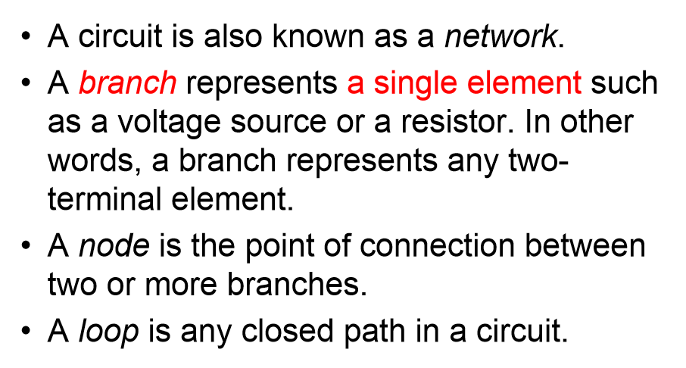

Slide 7

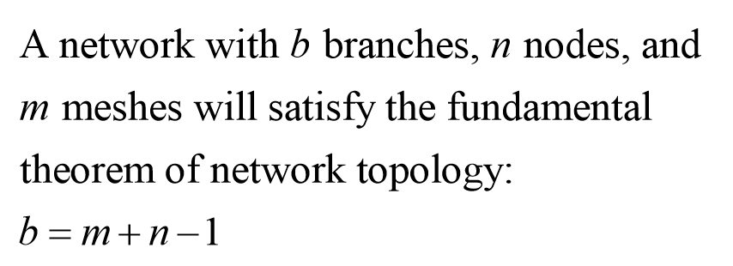

Slide 8
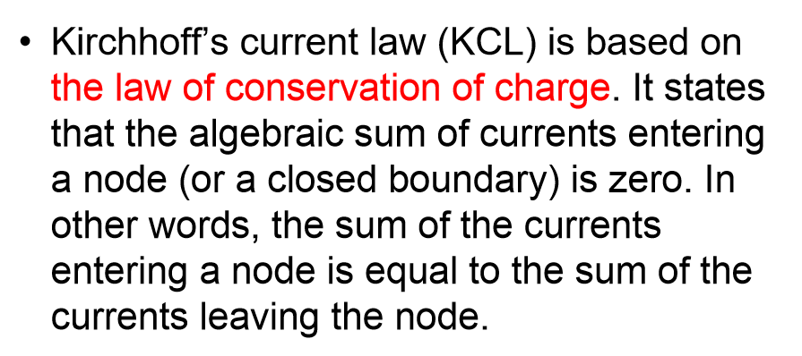
Basic and useful

Slide 9
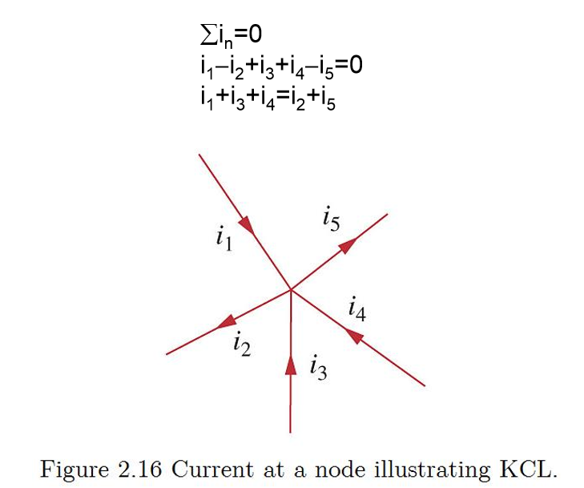
Choose node.
Count branches.
Mark the directions.
Sum…

Slide 10
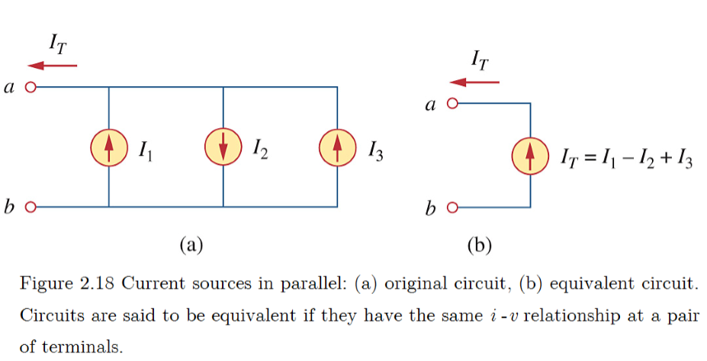
Important to simplify the circuit.
Parallel current sources.

Slide 11
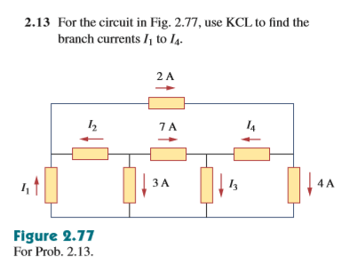

Slide 12
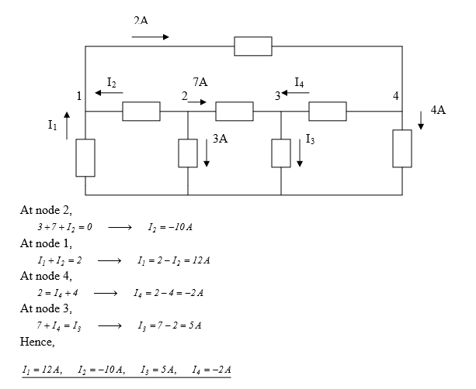

Slide 13

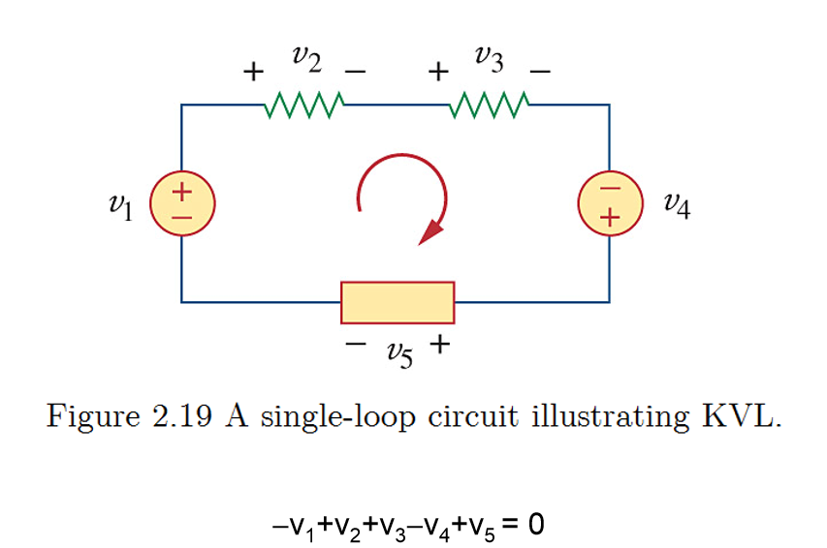
Similar as current law
Be careful with the positive and negative terminals

Slide 14
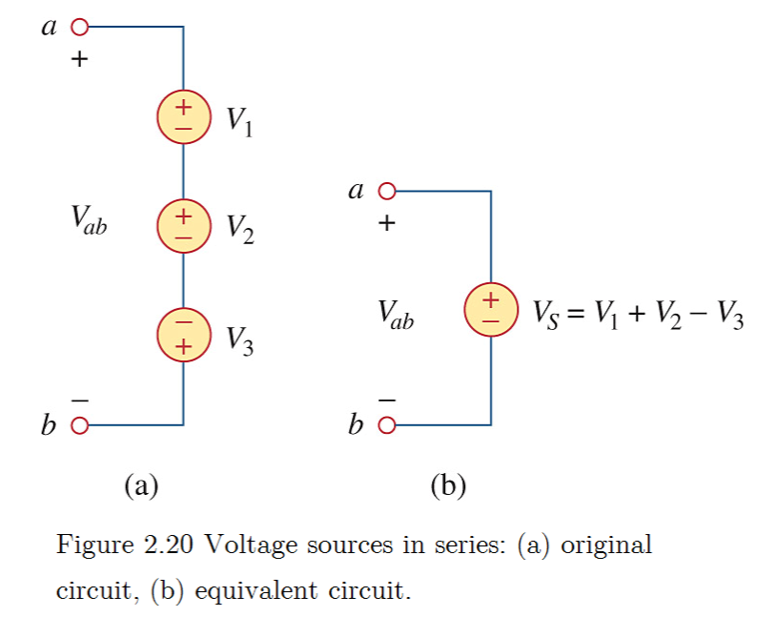
Important to simplify the circuit.
Series voltage sources.

Slide 15
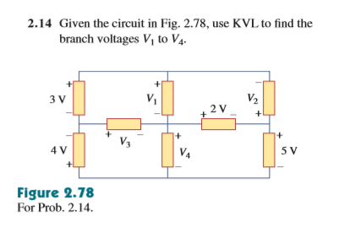

Slide 16
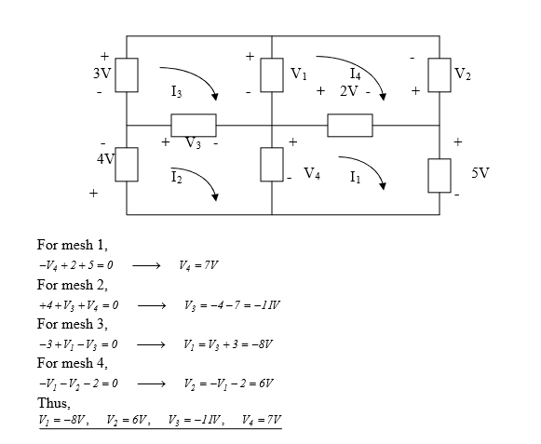

Slide 17
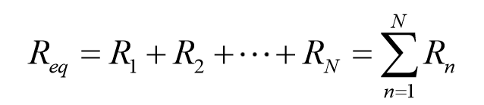
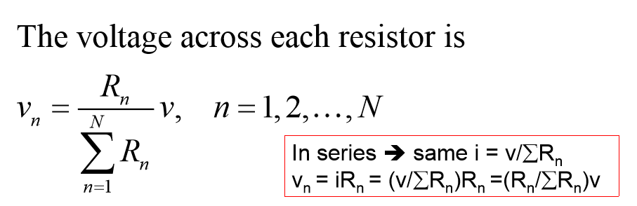
Series Resistors and Voltage Division
Series

Slide 18
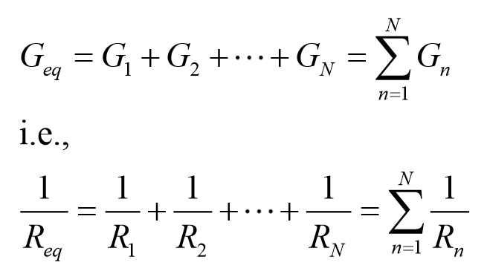
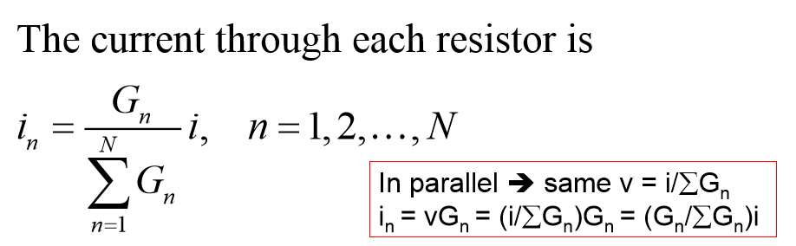
Parallel Resistors and Current Division
Parallel

Slide 19
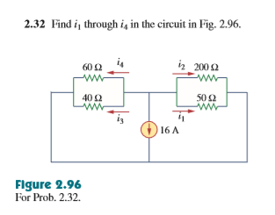

Slide 20
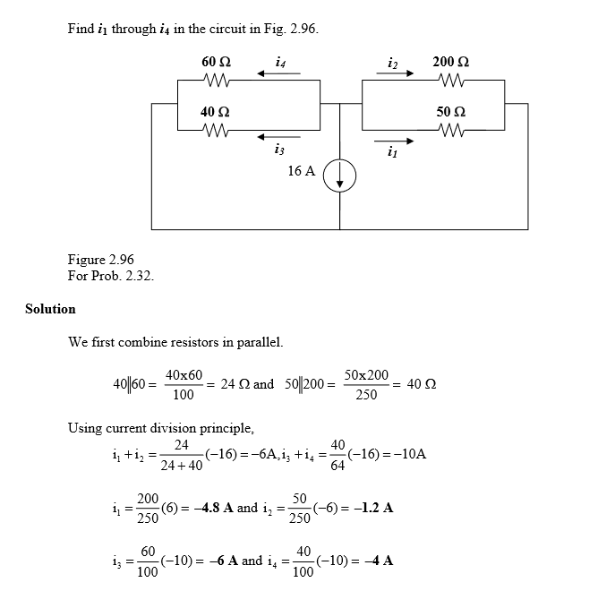
Current division

Slide 21
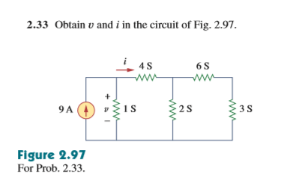

Slide 22
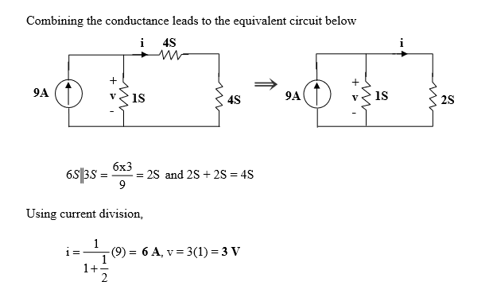

Slide 23

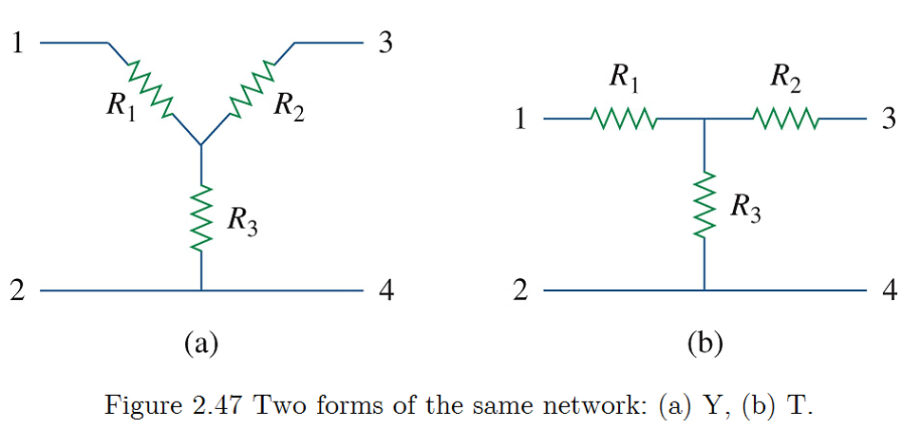
Wye

Slide 24
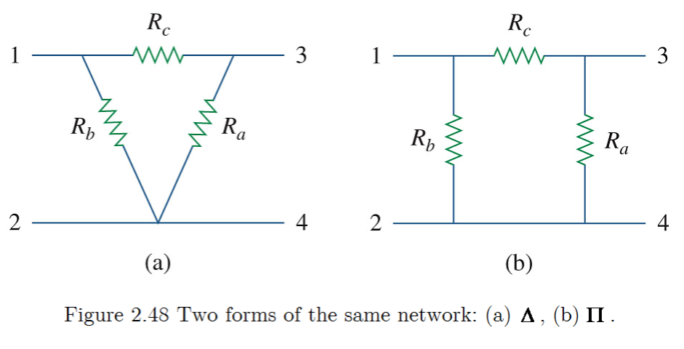
Delta
Can be changed between (a) and (b)

Slide 25
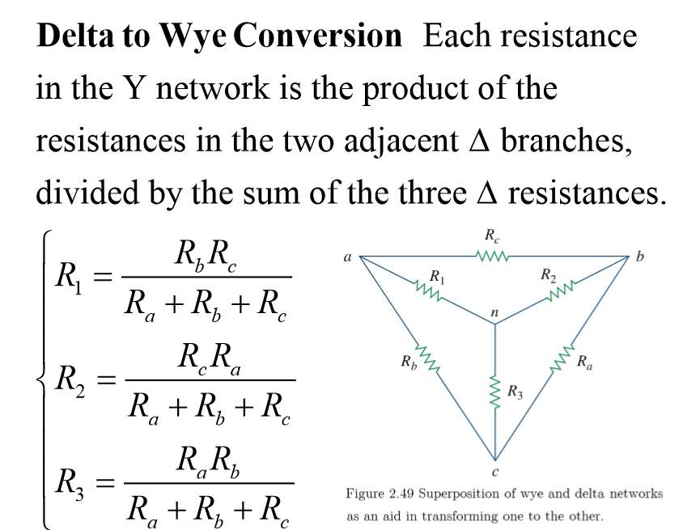

Slide 26
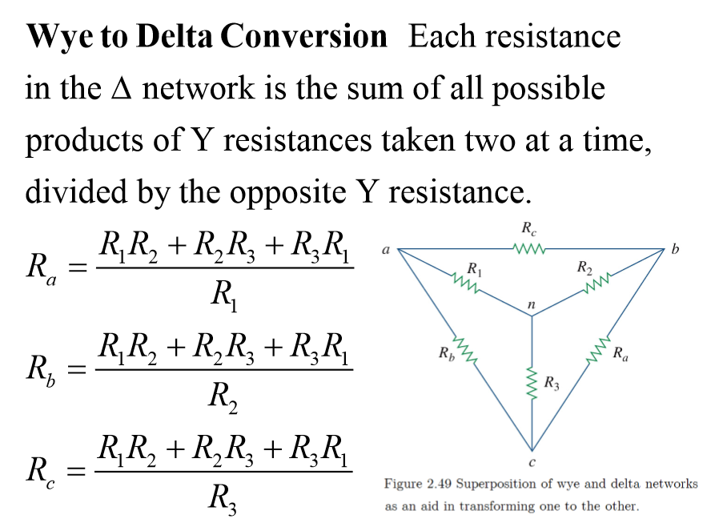

Slide 27
The proof of the conversion formula is not very important.
Using the formula proficiently and quickly.
The proof in the lecture slides is clear and if you have time and interest, you can try to prove it by yourself.
Be careful with the circuit and judge the Wye or Delta correctly.

Slide 28
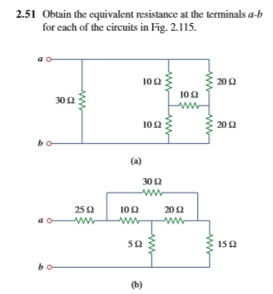

Slide 29
